Slide 1
Course Objectives
The Database Basics course provides
Basic database and query concepts
Establishes fundamentals for further DB trainings
Content: SQL syntax, data types, programmability
What is NOT covered?
Client-side implementations
API Libraries

Slide 2
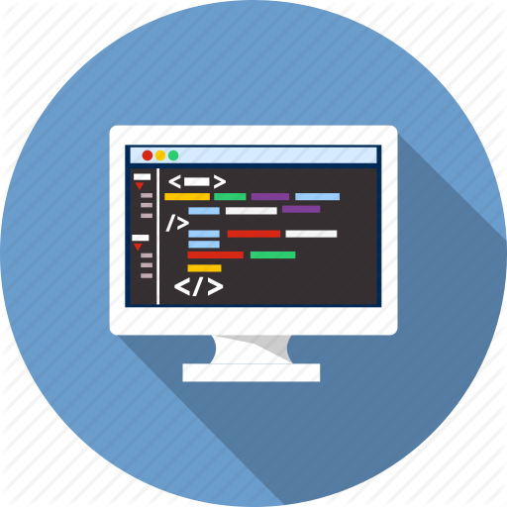


Course Topics
DB intro, concepts overview, functionality
Data definition and data types
Basic CRUD, intro to SQL
Built-in functions
Data aggregation
Table Relations
Subqueries and JOINs
Functions, Triggers, Transactions

Slide 3

Trainers Team
Simona Simeonova
Trainer @ Software University
Top performing student from the Software University

Slide 4

Trainers Team
Nikolai Bankin
Top performing student from the Software University (2014)
4 years of programming experience mainly with Java, PHP, HTML, CSS and JavaScript
Teacher at TUES

Slide 5


Scoring System for the Course
Mandatory:
Final exam – 85%
Homework submissions – 15%
Bonuses:
Presence in class – 5% bonus
Forum activity – bonus up to 5%

Slide 6


Homework Assignments & Exercises
Your homework is mainly work in class!
Lesson days → slides + live demos + exercises
Exercise days → only exercises
How to submit your homework?
Submitted in the judge system
Do your homework when it's due!
Assignments pile up quickly

Slide 7



C# Course Web Site, Forum and FB Group
Official web site:
Official discussion forum:
Official Facebook groups:
https://softuni.bg/courses/databases-basics-mysql
https://softuni.bg/forum/categories/77/databases-basics-mysql
https://www.facebook.com/groups/1806042899410408/

Slide 8


Java DB Recommended Software
Software needed for this course:
Microsoft Windows 10
HeidiSQL - https://www.heidisql.com/download.php
XAMPP - https://www.apachefriends.org/index.html

Slide 9



Learn to Search in Internet
The course assignments require to search in Internet
This is an important part of the learning process
Some exercises intentionally have no hints
Learn to find solutions!
Software development includes everyday searching and learning
No excuses, just learn to study!
Developers learn new technologies, tools, languages every day!

